Slide 1
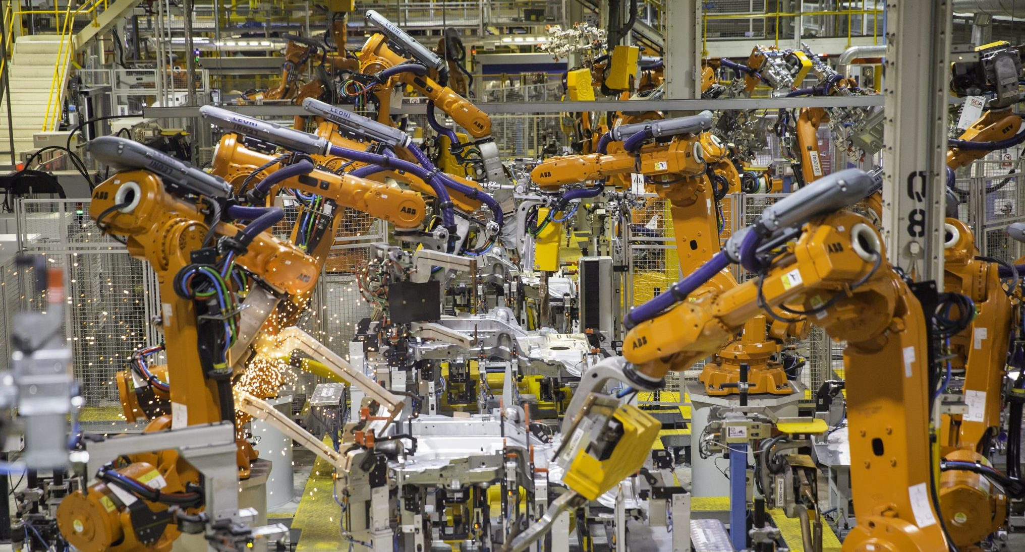
FSE 570 CAPSTONE PROPOSAL
Data-Driven Anomaly Detection and
Risk-Aware Maintenance Scheduling
for Smart Industrial Systems
Team Members: Anoushka Jaydas Dighe Deva Siva Kanth Tavvala Mohit Kumar Petla Umang Rajnikant Bid Urvansh Jignesh Shah
Arizona State University
Ira A. Fulton Schools of Engineering

Slide 2
THE CHALLENGE
Industry Problem
Equipment Failures Disrupt Production
Industrial machines generate massive sensor data, but unexpected breakdowns halt operations without warning.
Alerts Lack Prioritization
Monitoring systems flood operators with notifications but provide no guidance on which issues demand immediate attention.
Operators Must Decide Manually
Maintenance staff interpret complex data streams and make critical prioritization calls without systematic support.
Maintenance Resources Are Limited
Crews cannot address every alert simultaneously. Suboptimal scheduling leads to missed critical repairs.

Slide 3
IMPACT ANALYSIS
Why It Matters
Downtime Affects Operations
Unexpected Failures Create Safety Concerns
Reactive Maintenance Wastes Effort
Unplanned shutdowns cascade through production schedules, delaying deliveries and inflating costs across the supply chain.
Sudden equipment malfunctions pose risks to workers and can trigger hazardous conditions in industrial environments.
Fixing machines after they break consumes more resources than planned interventions and strains maintenance teams.
Production Impact
Risk Factor
Efficiency Loss
Schedule Disruption
Worker Safety
Resource Drain
The Cost of Inaction
Current approaches leave critical decisions to human judgment without data-driven guidance

Slide 4
SYSTEM ANALYSIS
Gap in Current Systems
What Current Systems Do Well
Monitoring systems successfully detect abnormal conditions and trigger alerts when sensor readings exceed thresholds.
The Critical Missing Piece
Key Insight
They do not recommend actions; operators receive alerts but no guidance on what to do next
The problem is not detection.
Operators interpret risk themselves, each technician makes subjective judgment calls
The problem is decision making.
No prioritization framework, all alerts appear equally urgent
Current systems inform operators that something is wrong. They do not guide operators on what to do about it.

Slide 5
OUR SOLUTION
Project Objective
Build a Maintenance Decision-Support System
Target Users
Design an intelligent framework that transforms raw sensor data into actionable maintenance recommendations.
Plant Operators
Monitor equipment health and receive actionable alerts
Use Heterogeneous Industrial Data
Guide Maintenance Decisions
Reliability Engineers
Analyze failure patterns and optimize maintenance strategies
Integrate sensor telemetry, maintenance logs, and operational context into unified analysis.
Move beyond status reporting to provide clear, prioritized action recommendations.
Maintenance Planners
Schedule crews and allocate resources efficiently

Slide 6
FOUNDATION
Data Sources
Heterogeneous data integration from multiple industrial streams
Sensor Telemetry
Operational Context
Real-time machine condition monitoring through multiple sensor types.
Environmental and scheduling factors that influence maintenance decisions.
Temperature
Vibration
Pressure
Speed
Power
Production Load
Shift Schedules
Crew Availability
Maintenance & Failure Records
Historical data on past repairs, component replacements, and failure events.
Data Integration
Repair History
Failure Logs
Component Age
Sensors
History
Context
Unified Model

Slide 7
SYSTEM ARCHITECTURE
Analytics Layer
Intelligent processing pipeline for anomaly detection and risk assessment
1
Detect Abnormal Behavior
3
Provide Uncertainty Confidence
Identify anomalous patterns in sensor streams that deviate from normal operating conditions.
Quantify prediction confidence to support risk-aware decision making under uncertainty.
Pattern Recognition
Outlier Detection
Bayesian Methods
Confidence Intervals
2
Predict Near-Future Failure Risk
4
Identify Contributing Signals
Forecast probability of component failure within upcoming operational windows.
Explain which sensor readings and patterns drive risk predictions for transparency.
Time-Series
Survival Models
Feature Importance
Explainable AI
Machine Learning
Neural Models
Bayesian Reasoning

Slide 8
DECISION ENGINE
Decision Layer
Transforming risk assessments into actionable maintenance plans
Combine Risk with Constraints
Merge failure probability with operational realities: crew availability, production schedules, and spare parts inventory.
Decision Flow
Risk Assessment Input
Prioritize Machines
Failure probability + uncertainty
Rank equipment by urgency using multi-criteria scoring that balances risk severity, operational impact, and resource constraints.
Constraint Integration
Resources + schedules + priorities
Schedule Maintenance Timing
Optimize when each repair should occur to minimize production disruption while addressing critical risks promptly.
Optimization Engine
Multi-criteria decision analysis
Recommend Actions
Actionable Recommendations
Generate clear, actionable guidance: which machine, what action, when to execute, and why it matters.
Prioritized maintenance plan

Slide 9
SYSTEM OUTPUT
Example Output
Clear, actionable recommendations for maintenance teams
Service Immediately
Critical Risk Level
High failure probability detected. Immediate attention required to prevent unplanned downtime.
Schedule Soon
Elevated Risk Level
Moderate risk identified. Plan maintenance within the next scheduled window.
Continue Monitoring
Normal Operation
Equipment operating within normal parameters. No immediate action required.

Slide 10
VALUE PROPOSITION
Expected Benefits
Qualitative improvements in maintenance operations
Reduced Unplanned Downtime
Better Resource Usage
Transition from reactive firefighting to proactive planning. Address equipment issues before they cause production stops.
Optimize crew deployment and maintenance windows. Allocate limited resources to highest-impact activities.
Predictive Approach
Early Warning
Crew Optimization
Schedule Efficiency
Improved Prioritization
Improved Reliability
Focus maintenance efforts on equipment that matters most. Data-driven rankings replace subjective judgment calls.
Build confidence in equipment performance. Reduce unexpected failures that disrupt operations and create safety risks.
Risk-Based
Objective Criteria
Operational Stability
Safety Enhancement

Slide 11
FSE 570 CAPSTONE
Course Alignment
This project demonstrates core competencies of the graduate engineering program
Heterogeneous Data Integration
Machine Learning & Neural Modeling
Bayesian Uncertainty Reasoning
Combining sensor telemetry, maintenance records, and operational context into unified analytical framework.
Applying advanced algorithms for anomaly detection, pattern recognition, and failure prediction.
Quantifying prediction confidence to support risk-aware decision making under uncertainty.
Engineering Domain Application
Actionable Decision Framework
Building a complete decision-support system that transforms data into actionable maintenance recommendations. This bridges the gap between analytics and operations, demonstrating the ability to create systems that deliver measurable value to industrial stakeholders.
Addressing real-world industrial challenges in smart manufacturing and Industry 4.0 environments.

